Slide 1

Insurance renewal System
Batch code [2104b1]
4rd semester: hdse-ii
Presented by:
Our Team Members: Furqan, Hassan,Hamza,
Wahaj & Farzam.
Notes:
This template can be used as a starter file for presenting training materials in a group setting.
Sections
Right-click on a slide to add sections. Sections can help to organize your slides or facilitate collaboration between multiple authors.
Notes
Use the Notes section for delivery notes or to provide additional details for the audience. View these notes in Presentation View during your presentation.
Keep in mind the font size (important for accessibility, visibility, videotaping, and online production)
Coordinated colors
Pay particular attention to the graphs, charts, and text boxes.
Consider that attendees will print in black and white or grayscale. Run a test print to make sure your colors work when printed in pure black and white and grayscale.
Graphics, tables, and graphs
Keep it simple: If possible, use consistent, non-distracting styles and colors.
Label all graphs and tables.

Slide 2

Introduction? Insurance Renewal System is an online e-Insurance Renewal System where any user can easily renew your car’s insurance yourself, without any facing hurdles, as well as they also registered themselves with this app. Moreover, they can download registered insurance info via pdf format. The purpose of this app is to facilitate those people who like to renew their car’s insurance.
Our Splash Screen:-
Notes:
Give a brief overview of the presentation. Describe the major focus of the presentation and why it is important.
Introduce each of the major topics.
To provide a road map for the audience, you can repeat this Overview slide throughout the presentation, highlighting the particular topic you will discuss next.

Slide 3

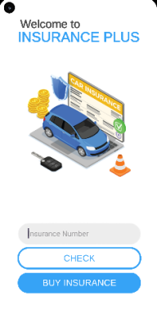
Home Screen:
After disappearing Splash Screen, Users can view this Main activity Page or Screen.
Where User(s) can check the insurance after buying /renewal of Insurance.
Notes:
This is another option for an Overview slides using transitions.

Slide 4
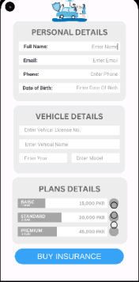
Buy Insurance Activity/ Page:
When User(s) click on the Buy Insurance button which is shown in Main Activity Page, this below page or screen will be appeared.
Where User(s) can view the Personal Details, vehicle Details and Insurance Plan.
User(s) can fill the details one by one for renew the policy as per the mentioned Policy plan.
Notes:
This is another option for an Overview slides using transitions.

Slide 5
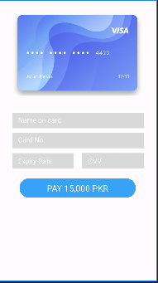
Payment Details Activity/ Page:
When User(s) click on the Buy Insurance button after filling all the information as we discussed on previous page, this below screen would be appeared for getting Payment Details.
Where User(s) can insert the details of his / her credit card for confirmed payment or renewed insurance.

Slide 6

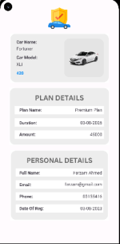
View Details Activity/ Page:
When User(s) click on the Pay Button which is mentioned above, his or her payment would be confirmed.
After Confirmation, user(s) can visit the Main activity page or screen where he or she can view the check insurance, whether his or her insurance will be renewed or not.
In order to check the renewed insurance, he or she insert his or her policy number in the given block, and then click on check button, if the data is visible in the form of view, his or her insurance have been renewed, as given in the right side of the main activity.

Slide 7
Summary
We studied following pages:
Splash Screen.
Home Screen.
Add Policy Renew Details Screen.
Payment Details Screen.
Check Insurance Screen.
Notes:
Summarize presentation content by restating the important points from the lessons.
What do you want the audience to remember when they leave your presentation?
Save your presentation to a video for easy distribution (To create a video, click the File tab, and then click Share. Under File Types, click Create a Video.)

Slide 8
Thanks for watching…
The End…
Notes:
Is your presentation as crisp as possible? Consider moving extra content to the appendix.
Use appendix slides to store content that you might want to refer to during the Question slide or that may be useful for attendees to investigate deeper in the future.

